Slide 1
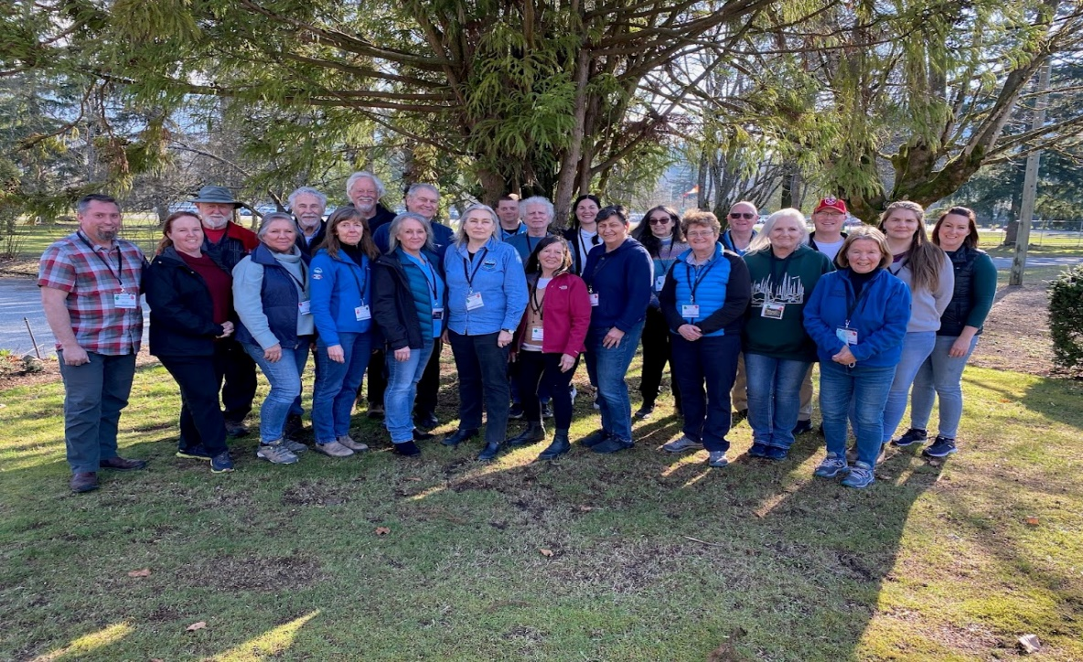
BCSARA CISM Program
Notes:
Introduce selves
Questions for audience
How many of you have an active CISM program for your organization?
How many are trying to create a new program?
How many of you work exclusively with volunteers? Paid employees?

Slide 2
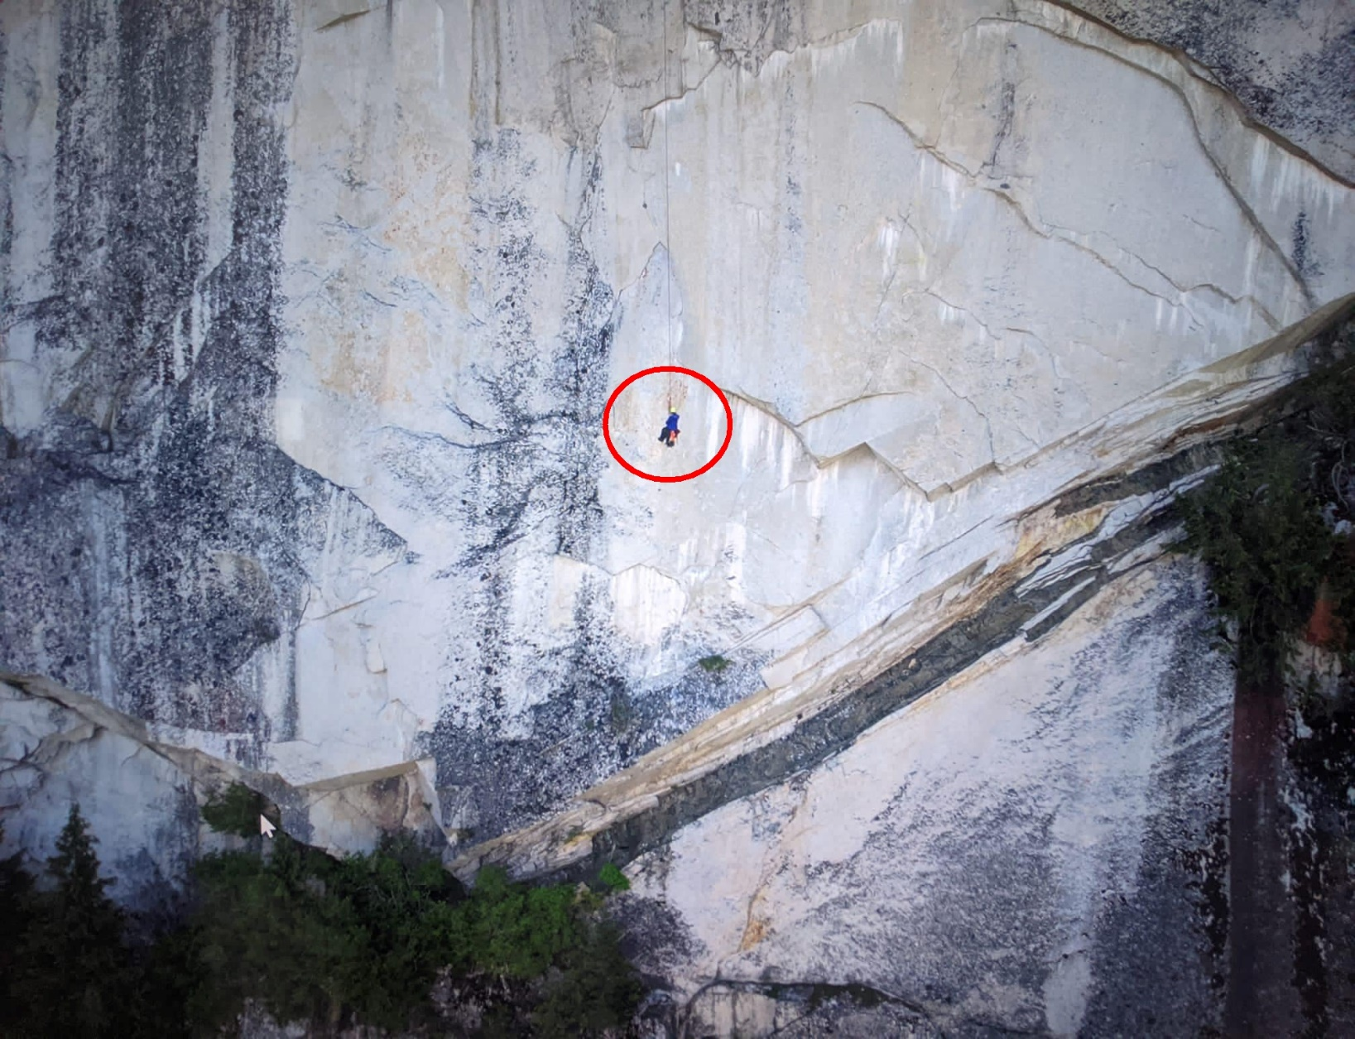
CISM overview
Critical incidents are those which overwhelm our regular coping mechanisms
Critical Incident Stress – common normal reaction to an uncommon/abnormal incident
Proximity to location and time of incident are important in providing interventions

Slide 3
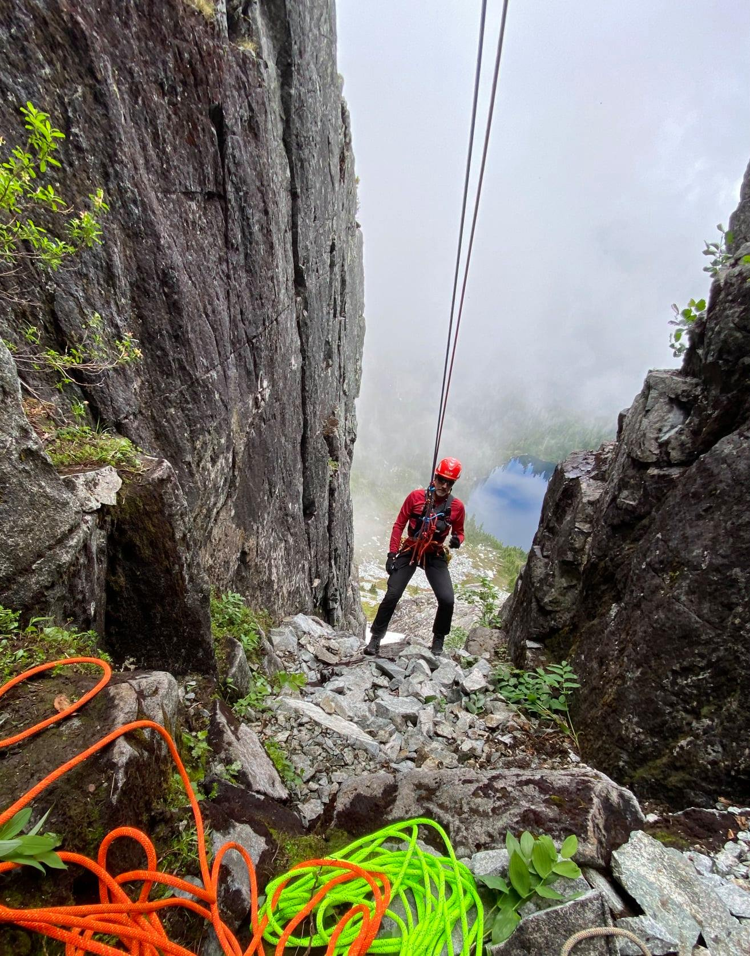
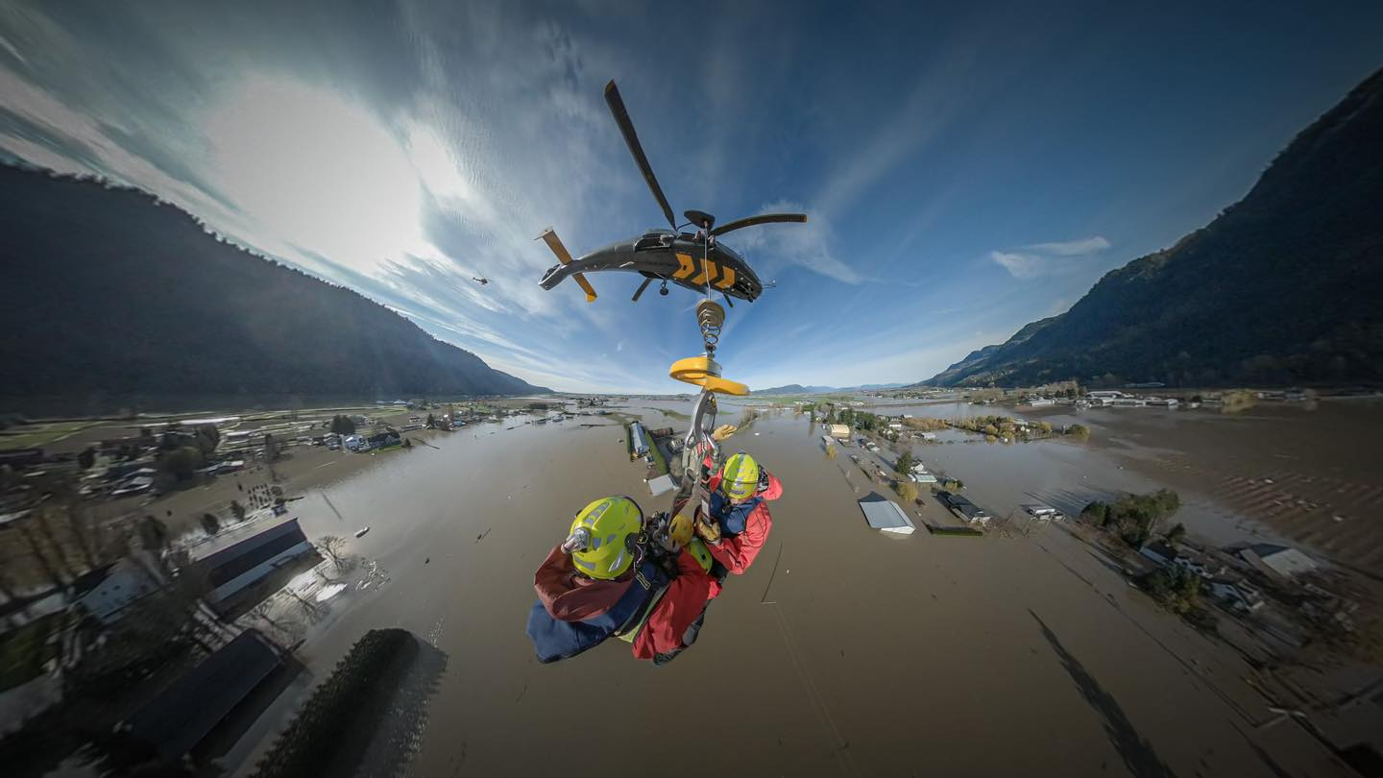
What would be a critical incident in your world?
Examples?

Slide 4
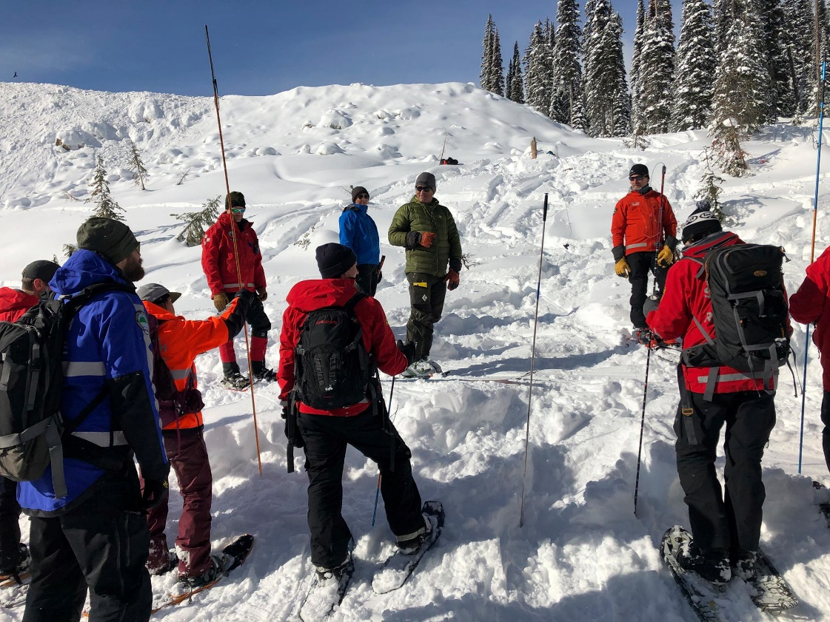
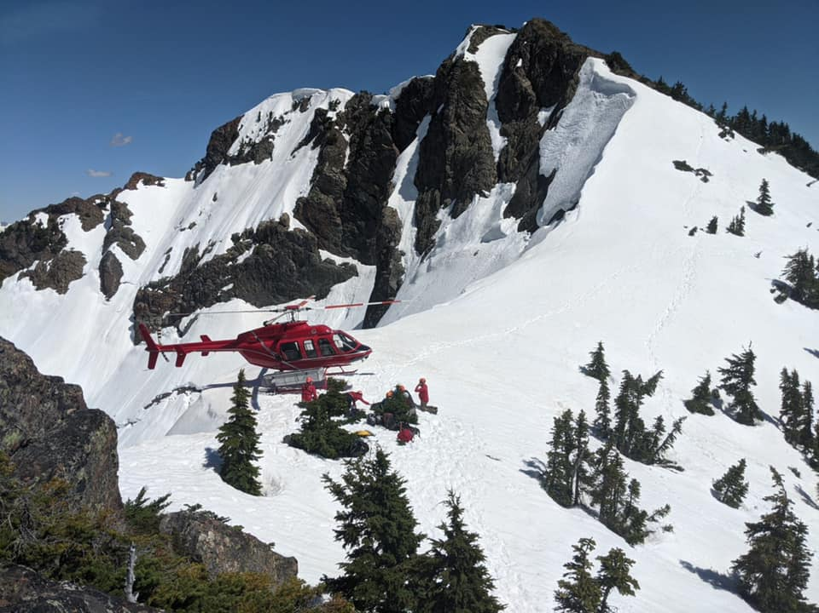
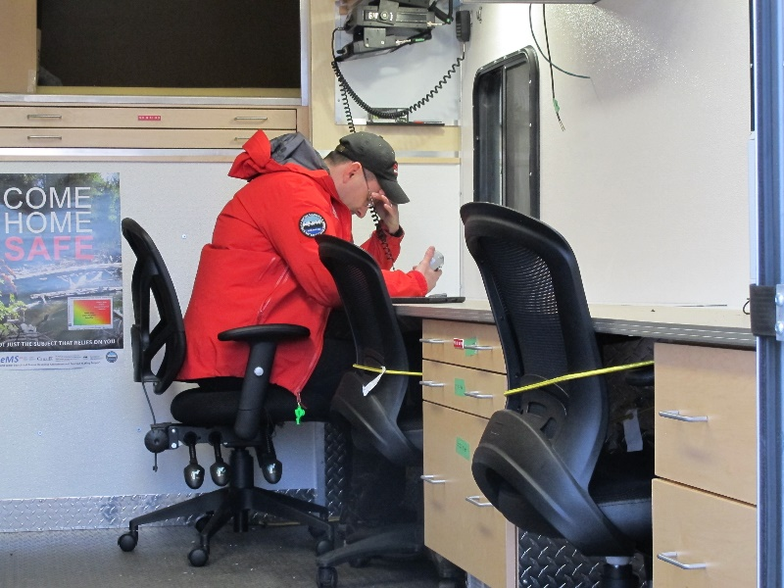
What do you see as common symptoms of critical incident stress in your world?
Five areas they may be seen:
Physical
Behavioural
Emotional
Cognitively
World Views

Slide 5
Why build a CISM program?
The need
80% of citizens will be exposed to a traumatic event; approx. 50% of disaster workers likely to develop significant distress
The benefits
Widely recognized to help participants return to pre-incident functioning faster with fewer/less intense disruptions
Early interventions reduce
the need for more intensive mental health services
Reduce burnout
Reduce the likelihood members/staff quit

Slide 6
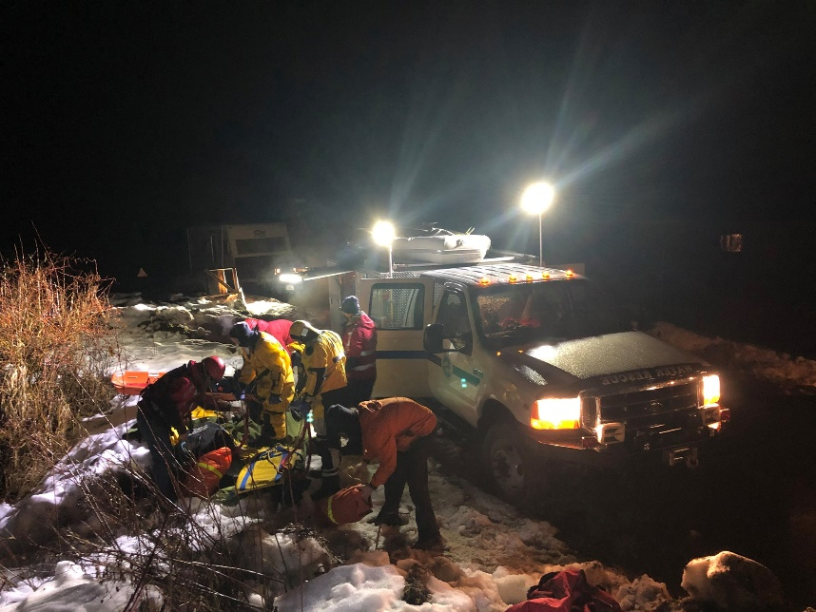
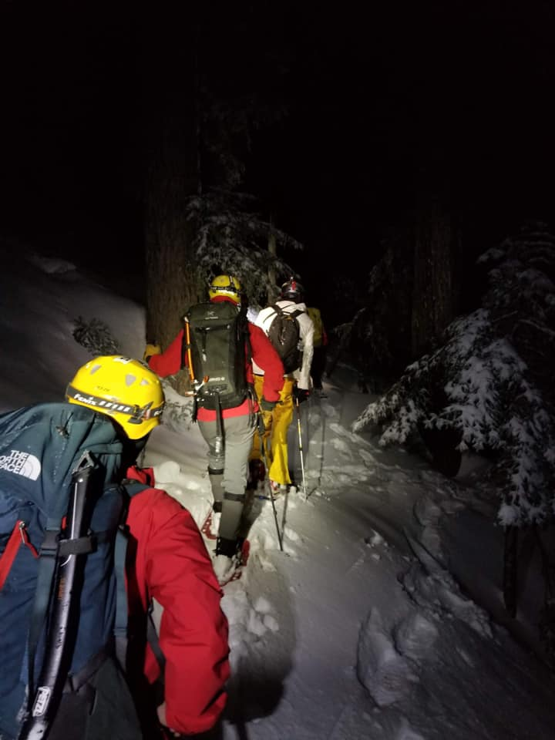
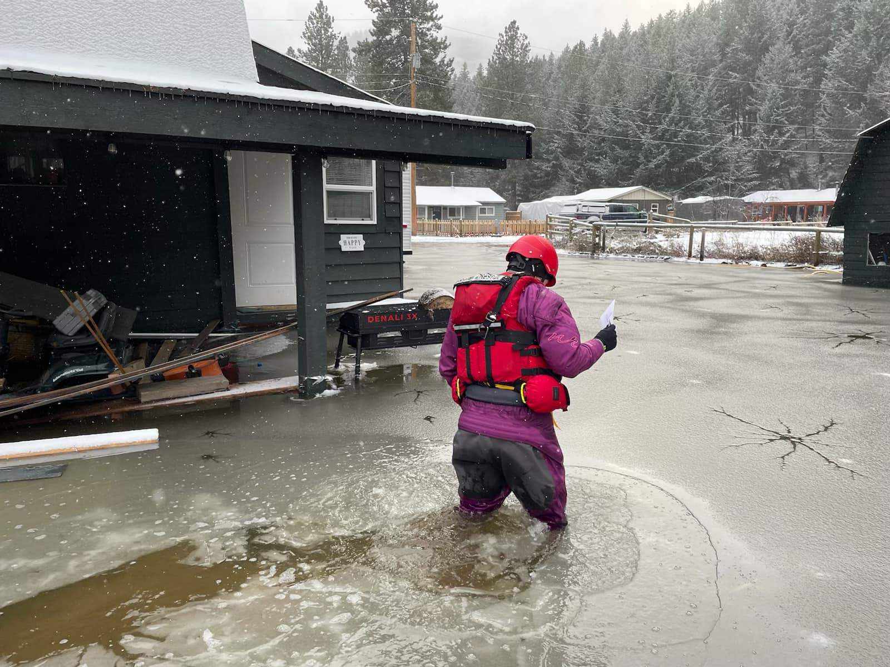
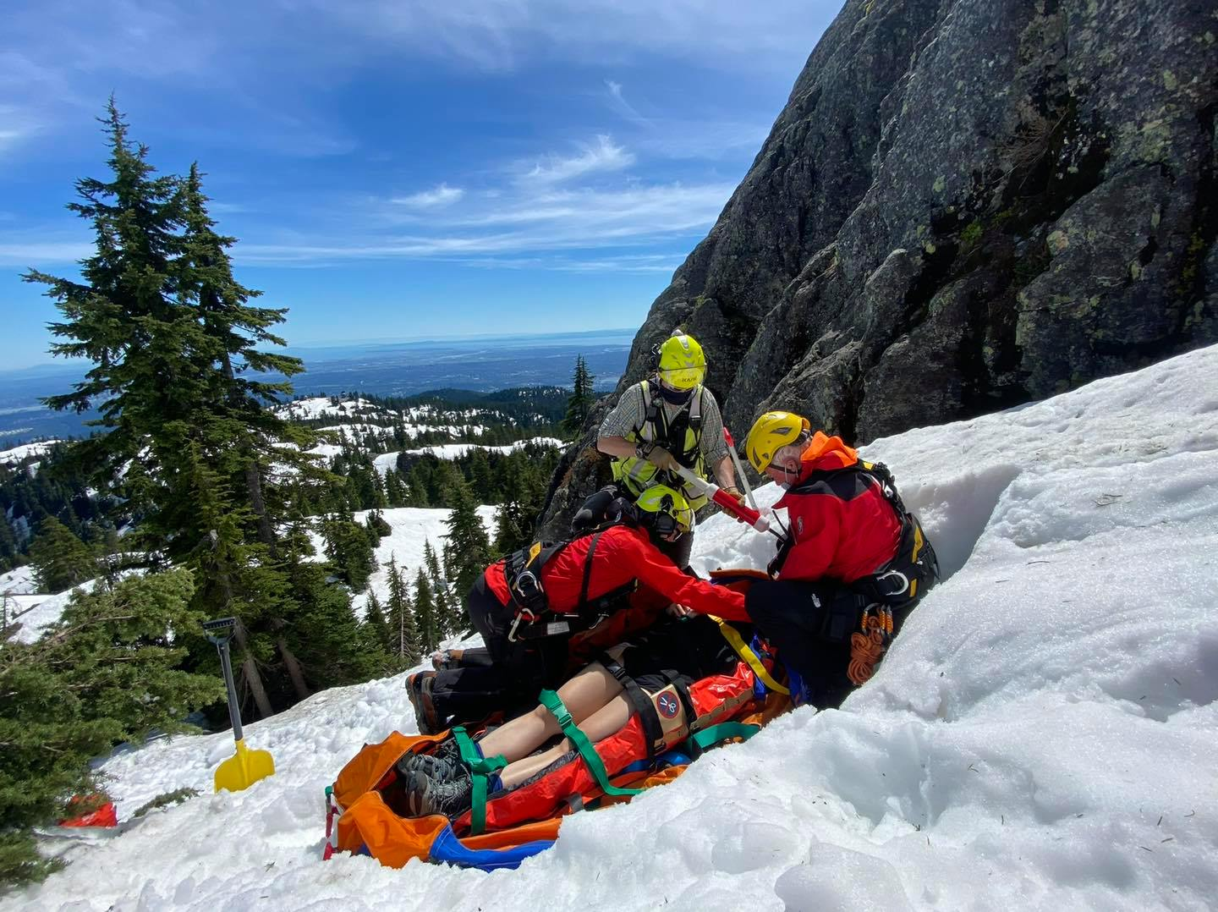
Why peer based?
They get it
They have been there
Speak the same language

Slide 7
Peer
Program
Components
Program Structure
History – Stakeholders
Elements of the program
Funding
2. Peer Training
ICISF Core courses
2 Annual face to face sessions
Monthly conference calls
Promotion &
Prevention
E & A committee
E & A awareness sessions
Promotional Material
Social Media presence
4. Interventions
RiT’s, CMB, CISD, 1 – 1
Follow up
Referral as appropriate
Notes:
Explain as you go through each point
Stakeholders
BCSARA
EMCR
78 SAR groups
3000 SAR volunteers and their support networks
Partner agencies including:
City police
RCMP
Coroner Service
BC Ambulance
Local governments
Fire Chiefs Assoc of BC
Training providers
Worksafe BC
Northern Insurance

Slide 8
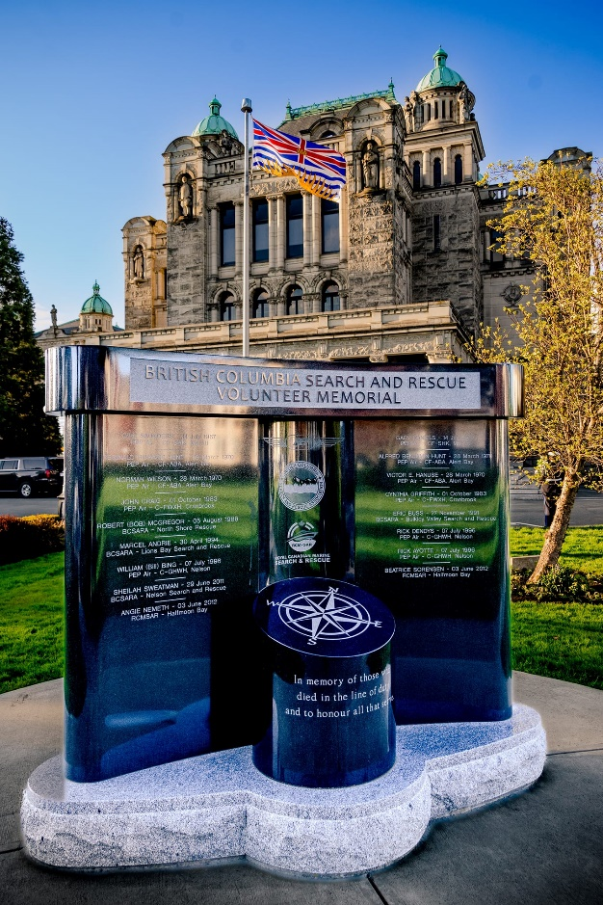
Why does BCSARA have a CISM program?
3400 volunteers in 78 recognized groups
1500-2000 SAR callouts annually
Many body recoveries (avalanche, swiftwater, flat water, wilderness)
Many recoveries involve death by suicide
Complex and technical nature of search and rescue in BC results in near misses and injuries for SAR volunteers
4 volunteer fatalities while training or line of duty over 30+ years
Program in existence since 2007

Slide 9
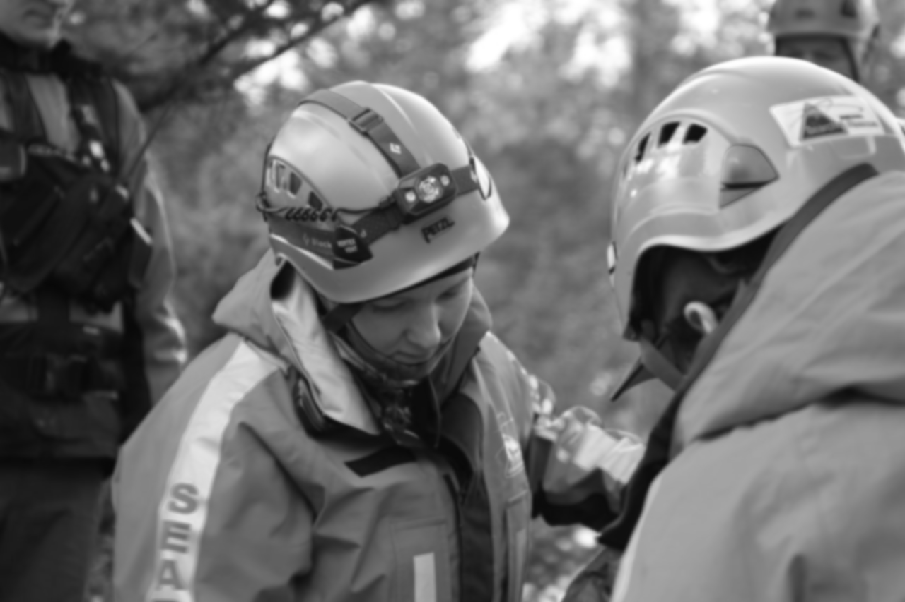
Managing the
Program
Steering Committee
Program Coordinator
HR Person
Clinical Director
Training Director
E&A Committee Chair
Dispatcher lead

Slide 10
Current Members
32 active peers across province of BC (including 8 new members in training)
Between 2 and 40+ years of SAR experience

Slide 11
Funding of program
Administratively – BCSARA funds the training of peers and promotional/education sessions for SAR groups and materials - $55,000/ year
Operationally - Providing interventions and supports for 78 groups/3400 volunteers
Expenses covered under task by the province (EMCR)
Travel, meals, accommodations, phone minutes

Slide 12
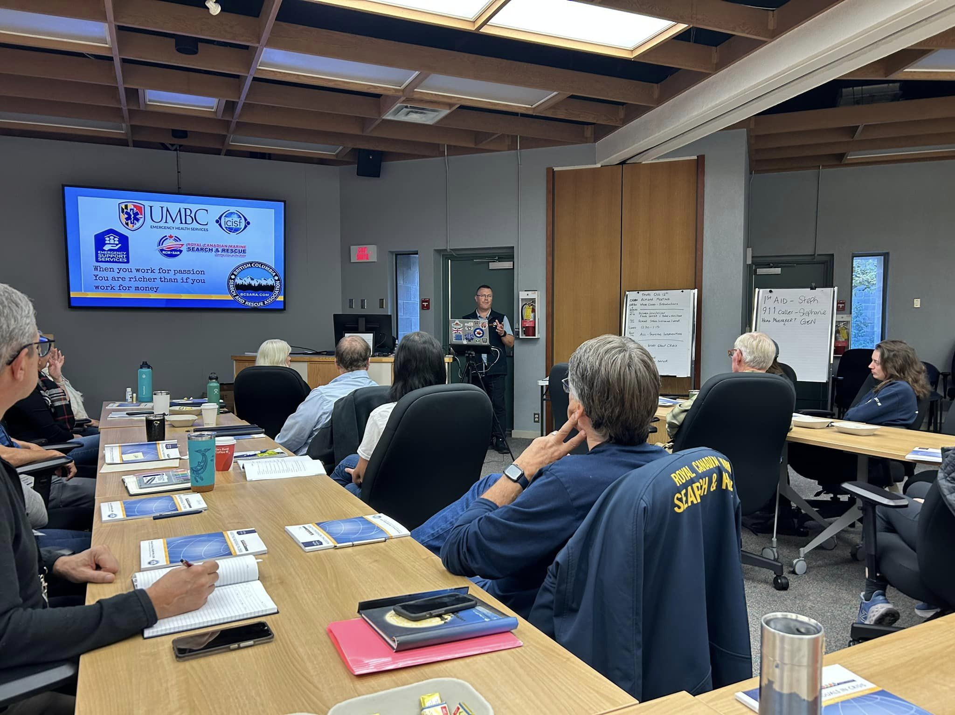
Peer training
Certified through the ICISF
All members get training to support individuals and groups in crisis
2 face to face 3 day training sessions annually bringing entire team together
Selected peers take advanced protocols for assisting individuals and groups

Slide 13
Recruitment of new peers
To qualify, the potential peer must be:
Fully trained as a ground SAR member
Active with recognized group for minimum 1 year
Geographically situated as appropriate
Submit application and resume
Zoom interview; phone all references; SAR community check
Extensive recruitment format
IMPORTANT DISCLAIMER: PEERS CANNOT PROVIDE INTERVENTIONS TO THEIR OWN GROUP

Slide 14
Peer training – 1 year probation
On going, face to face training happens 2 times a year, with peers travelling across the province to spend 3 days together
Training topics - Education/awareness presentations, issues from the recent interventions, suicide assessment, self care, grief interventions, cultural sensitivity and practice, practice, practice.

Slide 15
Education, Awareness and Promotion
A critical pillar of our program to inoculate members and groups before a critical incident, and to build the ability to bounce back after tough calls (resilience)

Slide 16
Education & Awareness sessions
Target groups: All SAR Teams in BC, at least once every three years
Before you send folks into the field you ensure they have the appropriate physical personal protective equipment, what about the appropriate psychological protection?
4 presentations
CISM 101 aimed at brand new members
CISM 102 deep dive into CISM
CISM 201 how to build resiliency as a SAR member, a SAR member supporter and a SAR group
CISM 301 Anatomy of SAR call – the physiology of CISM
EDUCATION & AWARENESS SESSIONS ARE FOUNDATIONAL TO BUILD RESILIENCY FOR VOLUNTEERS
Notes:
Info on the three presentations – target audiences
Who is in the audience
Need to make it interactive, engaging, movement
Importance of spouses/partners/significant others
Add piece on the primary value of education as the foundational piece for building resiliency into SAR volunteers

Slide 17
Education & Awareness sessions
4 video based resources on our Youtube channel
Post task wise practices
How critical incidents affect us in our 5 domains
Building resiliency
SAR is a family affair
EDUCATION & AWARENESS SESSIONS ARE FOUNDATIONAL TO BUILD RESILIENCY FOR VOLUNTEERS
Notes:
Info on the three presentations – target audiences
Who is in the audience
Need to make it interactive, engaging, movement
Importance of spouses/partners/significant others
Add piece on the primary value of education as the foundational piece for building resiliency into SAR volunteers

Slide 18
Education & Awareness sessions
Best practices
Include spouses, partners, significant others in the presentation
Happens after a new intake of members – critical
After a significant incident
EDUCATION & AWARENESS SESSIONS ARE FOUNDATIONAL TO BUILD RESILIENCY FOR VOLUNTEERS
Notes:
Info on the three presentations – target audiences
Who is in the audience
Need to make it interactive, engaging, movement
Importance of spouses/partners/significant others
Add piece on the primary value of education as the foundational piece for building resiliency into SAR volunteers

Slide 19
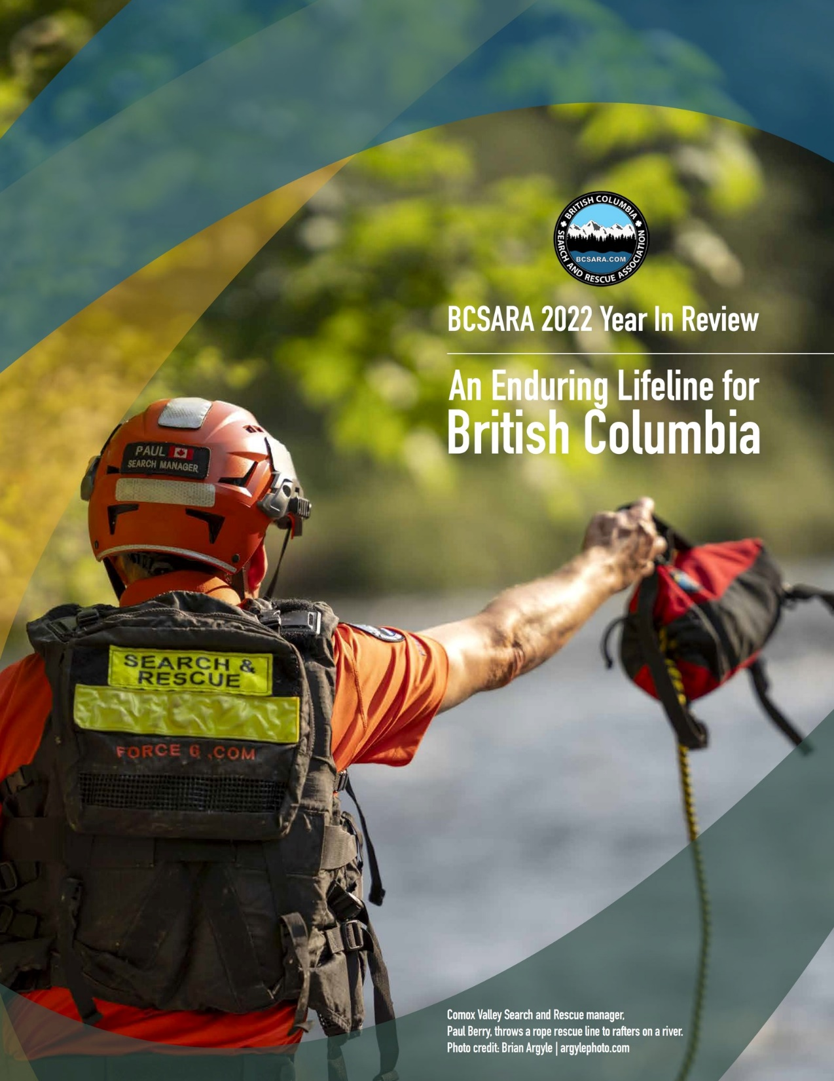
Promotion/Prevention
At search and rescue regional, provincial and national conferences, along with provincial board meetings, our program has standing agenda items:
Best practices
New presentations
Updates on stats
Themes from past season
CISM presence in every SAR training manual and certification course
Regular presence on social media
#CISMSaturday
Notes:
Cornerstone of the program
Explain who attends these meetings
Social media and BCSARA website viewed by public as well

Slide 20
Interventions
Should not be the only service your organization provides
Range of different interventions depending on the number of folks impacted and the time since the incident

Slide 21
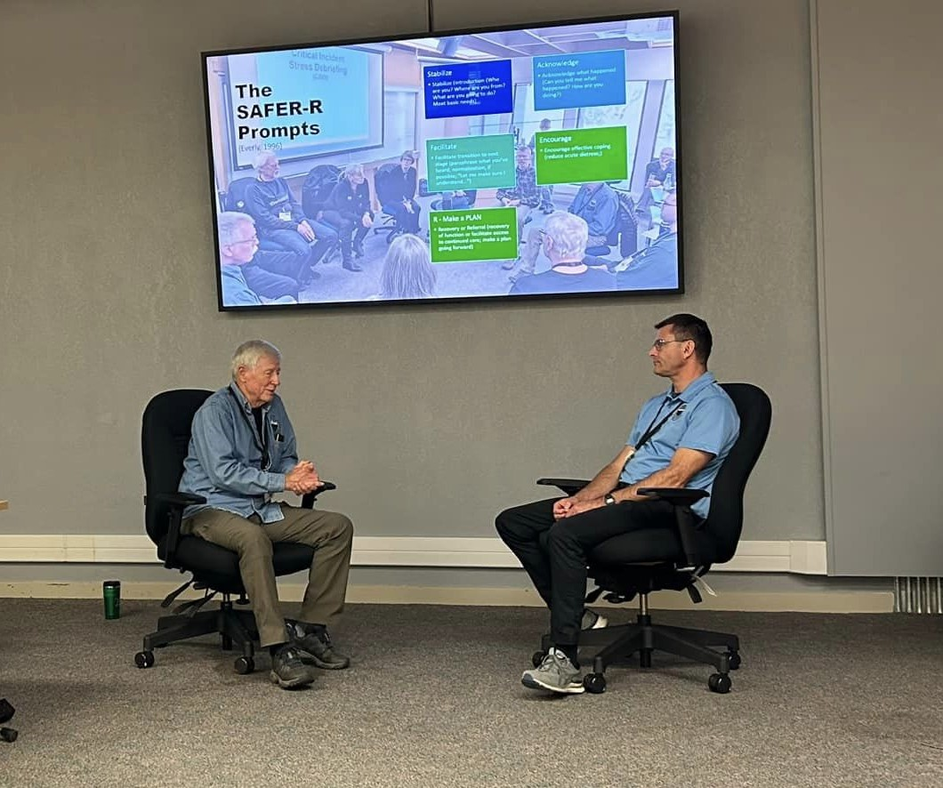
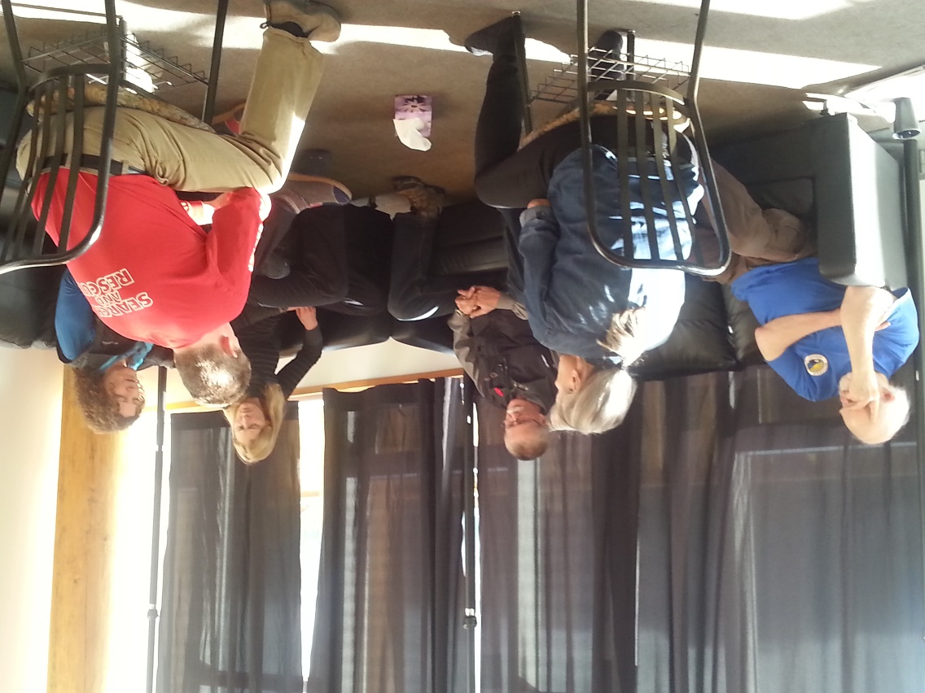
Main Interventions
Group CIS Debrief (7 step)
1 on 1
Group CIS Defusing
On Scene support

Slide 22
Call volume
2023 call volume to date - 61
Program supports 400-500 members each year
Notes:
Generally the number of interventions is higher than the team incidents as one SAR task can generate more than one intervention
In the last 4 years the program consistently supports between 400-500 SAR members each year.

Slide 23
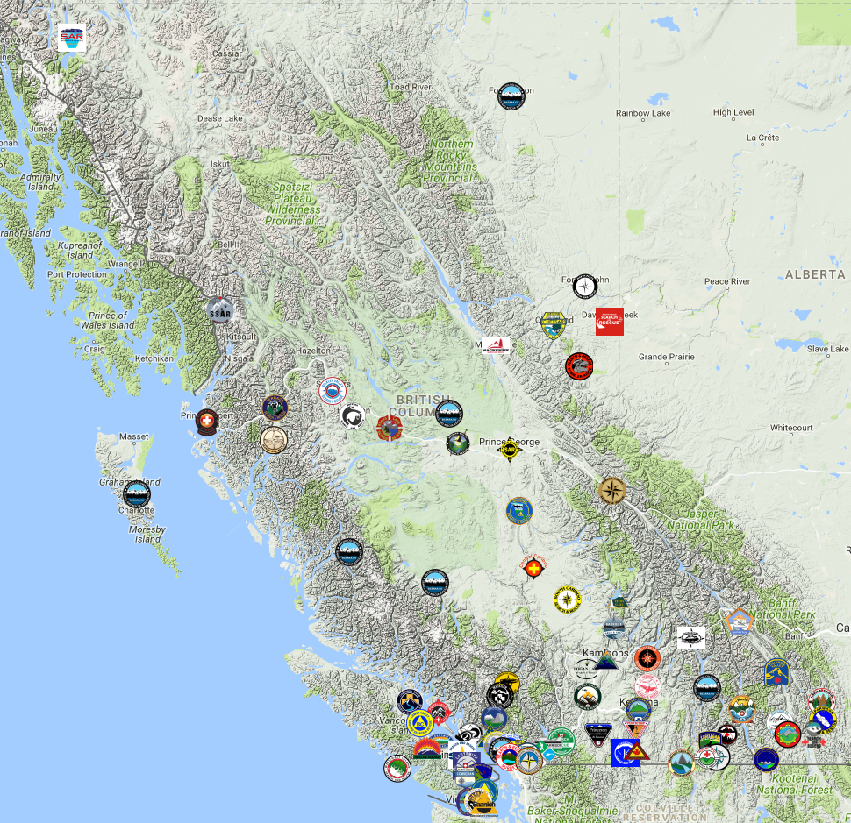
How a call out works
Request received, vetted and dispatched
2-3 peers travel to group location
Meet beforehand with group member
Intervention(s)
Travel home
Follow up calls
Debrief with dispatcher/clinical director
Response times for services – by phone, within the day; in person, within 24 hours (but can be up to 72 hours)
Most in person interventions are 36-48 from portal to portal

Slide 24
Wise practices…lessons learned
Foster collaborative and supportive relationships
Give time for community to embrace program
Encourage dialogue and discussion when CISM related topics are on the table rather than a top down, policy driven approach

Slide 25
Wise practices…lessons learned
Support volunteers outside of SAR specific instances
Support for non-SAR members (pilots, police)
Grief supports
Mental health supports outside of program
Supports for historical incidents
Peer self care and checking in after callouts
Education program should include posters, pamphlets, fridge magnets, social media presence and online resources

Slide 26
Best practices…lessons learned
Spell out peer expectations clearly (participation policy, attendance requirements, staying inside program boundaries, etc)
Recruit peers with mental health background but respect the limits of our practice and all trained the same.
Have peers from around entire jurisdiction

Slide 27
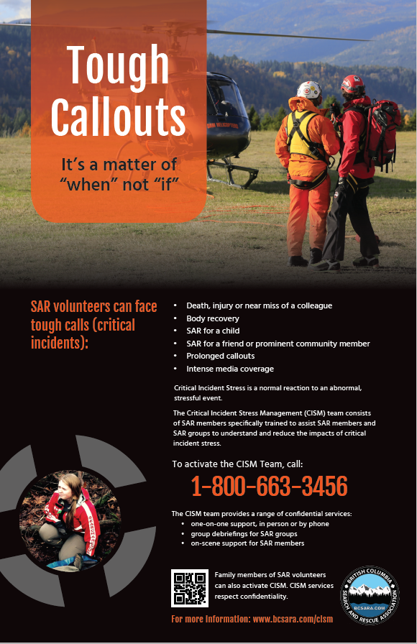
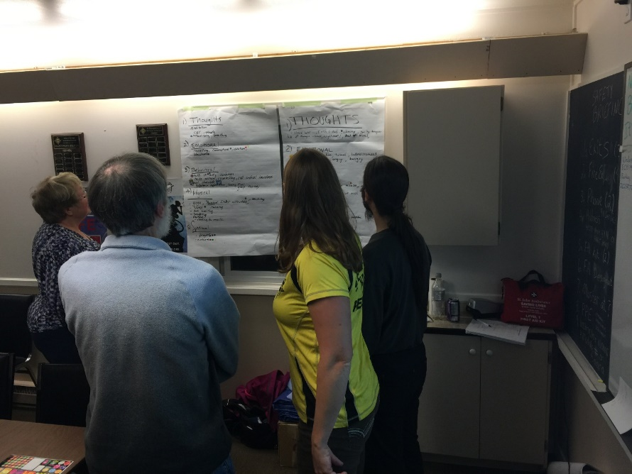

Slide 28
Discussion topics in community
Who is eligible to use the program?
How would a person contact the program? Who vets requests?
How would the program dispatch their peers?
Who would “manage” the peers in the field during their deployment?
Are there expenses to be claimed? How is this handled in a timely fashion?
Who will fund the training?

Slide 29
Wanting to start a program?
Peer based or non-peer based or outside provider? For those using the program, where is the best buy in?
Jobs include:
program coordination, contact system, dispatch system, finance person, training coordination, education program coordination, clinical direction
Funding for initial training of peers, on-going annual training, education program, intervention expenses
Costs for training peers – approx. $400-500 per peer plus cost of instructor travel/Accommodation or $450-$550 USD online (ICISF PRICE)

Slide 30
Year in Review
https://bcsara.com/wp-content/uploads/2023/09/BCSARA_2022_Year_In_Review_Report.pdf

Slide 31
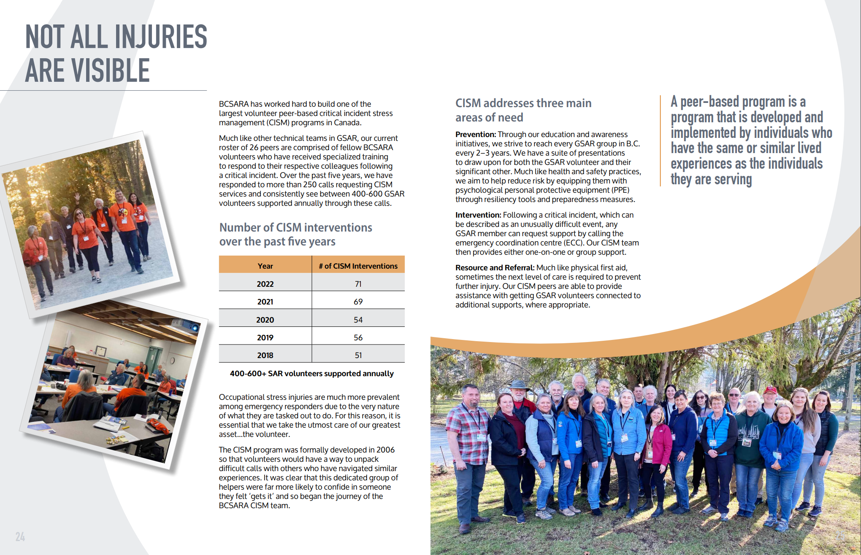

Slide 32
Contacts
BCSARA CISM program www.bcsara.com/cism
Greg Miller gmiller@telus.net
Chris Mushumanski mushumanskic@gmail.com
THANK YOU!

