Slide 1
ASKING THE TOUGH QUESTIONS
WHY WE SHOULD INCLUDE MENTAL HEALTH QUESTIONS DURING PRE-TRIP SCREENING
Created by Jill Zeppa & Sarah Coulter
Presented by Sarah Coulter
Notes:
Shoutout to Jill
land acknowledgement

Slide 2
OUTLINE
Trigger Warnings
Disclaimer
About Me
OBC Programs Overview
Our Screening Process & Important Considerations
Mental Health Considerations & How to Set Up for Success
Case Studies
Conclusion
Q&A

Slide 3
⚠️ TRIGGER WARNING ⚠️
WE WILL BE DISCUSSING DISTRESSING AND POTENTIALLY TRIGGERING TOPICS REGARDING MENTAL HEALTH
BELOW IS A LIST OF TOPICS THAT WILL BE DISCUSSED:
ANXIETY
DEPRESSION
CHALLENGING LIFE EVENT(S)
POST TRAUMATIC STRESS
SELF-HARM / SELF-INJURY
SUICIDE IDEATION, ATTEMPT/ GESTURES
PLEASE TAKE CARE OF AND BE KIND TO YOURSELF - IF YOU NEED TO OPT-OUT AT ANY POINT, PLEASE FEEL FREE TO DO SO.

Slide 4
DISCLAIMER:
GET YOUR OWN
INSURANCE & LEGAL ADVICE
Notes:
I’d like to start us off by reminding you that today’s presentation is not legal or insurance advice, and that what works for one program may not necessarily be the best fit or cover you for all risk mitigation needed for your own programs. Please do get your own advice from your insurance and legal consults to ensure that your programs are well covered and understood, in the context which they are planned and executed. Now let’s dive in!

Slide 5
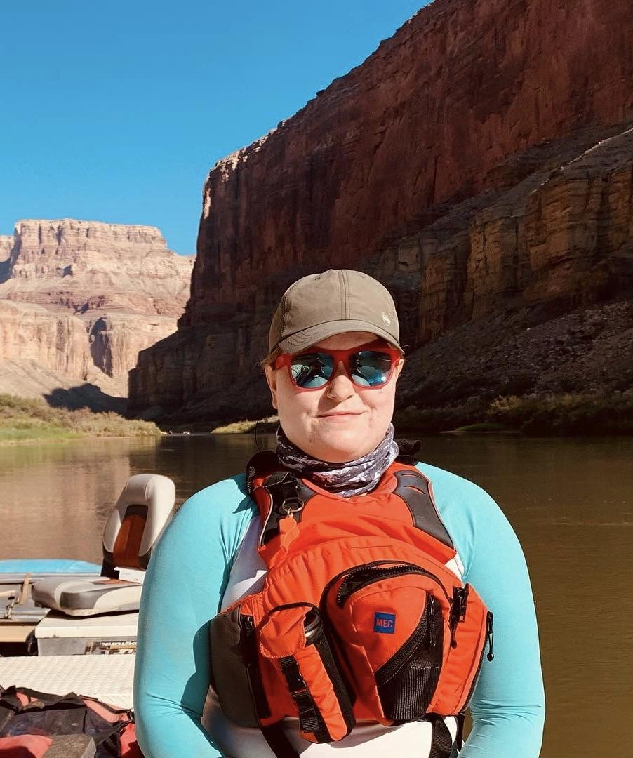
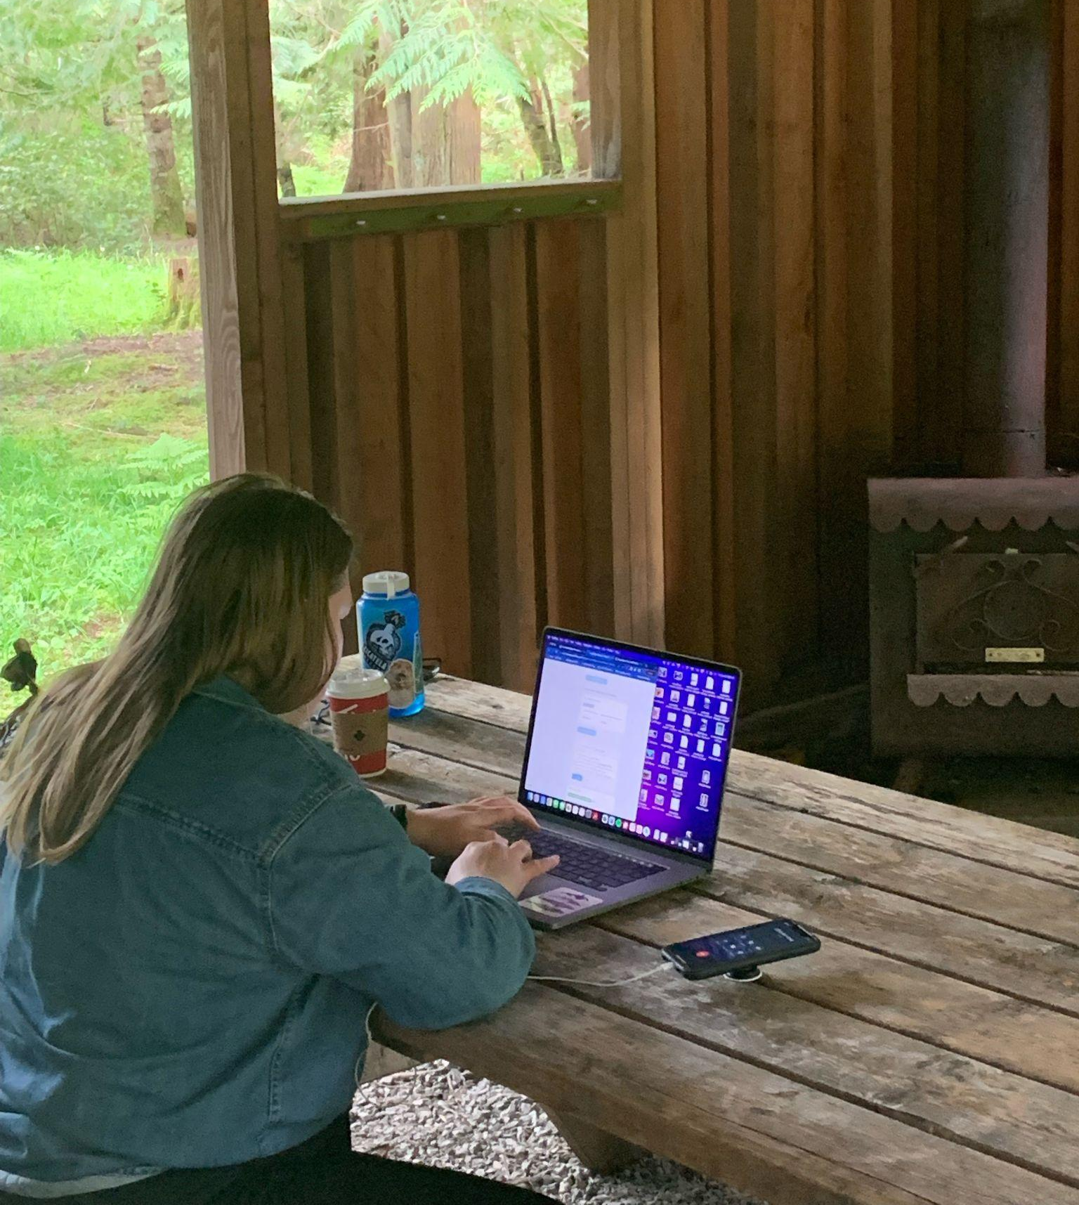
ABOUT ME!
Worked at an overnight summer camp in Georgian Bay since 2013 - focus on overnight canoe tripping
Studied Physical Geography at the University of Victoria, and took a specialization in Coastal Ecosystem Studies
Been on plenty of personal trips - including taking 18 days to raft down the Grand Canyon in 2021!
At OBC, I work primarily as an Admissions Coordinator for our summer programs
I also act as a Course Director, supporting instructors and students in the field
Notes:
I started working as a camp counsellor and tripper at a YMCA camp in Ontario, which is where my passion for the outdoors really began! I was able to do a 14-day canoeing expedition in the Temagami Lakes region which really started me down the outdoor education path
I then went on to study physical geography first at Queen’s University, then transferred to UVic, where I was able to specialize in Coastal Ecosystem Studies - I love being on the water!
At this time, my peers and I were also going through many struggles with our mental health, and found that after every field work day, or weekend trip to Tofino, we felt human again - and that’s when it clicked!
I really started to get into going on personal expeditions with friends. Many were notable, but my favourite so far has definitely been an 18 day whitewater rafting trip down the Grand Canyon
It was truly a life changing experience
My journey with Outward Bound is still in it’s beginning stages, but I’ve learned a lot so far! I primarily work as an Admissions Coordinator, which I’ll get into exactly what that entails throughout this presentation.
I also do some work as a Course Director throughout the season - CDs act as logistics and leadership support for instructors and students that are out in the field. I’ve found this helpful and important for me to understand exactly what students can be exposed to, and be able to help them better prepare for our programs!
You can see me juggling both of these jobs in the bottom photo - helping out with a program and also doing screening calls!

Slide 6
Programs at OBC
Main Activities:
Backpacking
Sea Kayaking & Canoeing
Flatwater Canoeing
Whitewater Canoeing
Main Tripping Areas:
Rocky Mountains
Clayoquot & Desolation Sound
Northern Ontario
Nova Scotia & Newfoundland
Length of Program
Day Programs
7, 14, 21, and 32-Day Overnights
Notes:
To give you an idea of what kinds of physical challenges our programs present, here is an overview of what a typical OB course spread looks like.

Slide 7
THE INTAKE PROCESS
Registration Process & Requirements
Forms
Phone and/or Video Calls
And lots of emails!
Supporting Resources
Partners
IMPORTANT CONSIDERATIONS
Be Trauma-Informed
Anticipate Barriers (i.e. Language, internet access, etc.)
Have a Sense of Cultural Competency
Confidentiality!
Notes:
Firstly, let’s talk about the components and considerations of your intake process. What you require from your participants through the intake process will be different for everyone, depending on what you have planned for your program and what risks you need to mitigate.
At OBC, we start the process by requiring specific forms to be completed: a Code of Conduct Form, a Photo and Research Release Form, and a Confidential Medical History Form. Depending on the program, we also require some additional forms in a questionnaire format, used to assessed student interest, motivation and readiness with insight from the youth and also from their parent/guardian.
After the forms come in, we aim to make an assessment prior to contact to the family, and we also aim to connect by phone to speak with each applicant and oftentimes their parent/guardian for youth as well. The purpose of this call is two fold: we often need to gather more information about their health history in the context of the program, and we aim to share information and allow folks to prepare mentally for what they are about to experience on the program.
This also helps us gauge how motivated students are to participate in the program, which is a large part of success on any program!
Sometimes we have more follow up steps in our process, which might include a consultation with the applicant’s doctor, specialist or counselling provider
Keep in mind that all of this is in the context of preparing for a backcountry expedition program - one in which students will travel far from their usual comforts and supports of home, and that particular coping strategies to managing stress and challenge will be a key tool for finding success on the program
Not to mention being further away from medical treatment as well
OBC also runs a variety of shorter programs, day programs in a front country environment. The intake system is quite a bit different for those programs, not nearly as detailed and quite a bit more accessible from the position of who we can support on the programs and set up for a successful experience.
So what resources do we use to conduct this important work? As you already know we have these intake forms. We also have a series of supplementary forms, which are designed to gather more information on specific medical history and conditions, if required. For example, we have a specific additional form for any applicants who live with managing diabetes.
We also have a very detailed Screening Manual, which is a training and reference tool, and it is required that all staff doing admissions intake are following the policies of our manual. The best tools this manual offers is very clear acceptance criteria and very clear contraindications to acceptance, depending on the challenge level of the program.
OBC also has a board of volunteer Medical Advisors
They sign up to support us create the most appropriate and up-to-date safety measures for the physical and mental health conditions we see the most
All of our medical advisors have some form of experience and understanding on the backcountry
We have advisors that specialize in medicine for physical health, and advisors that specialize in mental health as well
They help us both with updating our Screening Manual, but also in the field
We are able to contact the on-call medical advisor and get medical advice during programs when in the field
Reference to additional tools for trainee learning
Our team also engages in many external trainings, workshops, and resources to keep our skills up to date and relevant to the physical and especially mental health struggles the participants we serve are going through
A fantastic example would be Daye’s course!
So what are some other important considerations you need to keep in mind when setting up your system?
Being Trauma-Informed is an approach that we have found helps us to serve our students optimally
We will sometimes get information from participants about what they have been through and their personal history, but we will often not get the full story - and that’s okay!
Your potential clients will often have gone through many struggles throughout their life experience, and it’s important to understand that what questions and more importantly, how you ask them, may be triggering - which is the last thing we want to do!
It also helps your clients trust in a relationship that has essentially been strictly made over the internet or the phone, and open up more genuinely about any supports they may need during the program - this will in turn help your instructors and field staff in the long run
By acknowledging the resilience of your clients, you see what they will bring to the program, not how they may detract from it
[about barriers - anticipation and response]
[about cultural competency]

Slide 8
CONSIDERING MENTAL HEALTH
What are you looking for?
Phone call vs. video call
How you ask questions matters!
Consultations - their doctor? Your team? Medical Advisors?
Allow opt-outs, but explain limitations
SET UP FOR SUCCESS
Build a strong rapport
DO THINGS AS EARLY AS POSSIBLE!
Use the tools at your disposal
Transparency & compassion are your greatest assets
Notes:
CONSIDERING MENTAL HEALTH
Mental health is definitely more of a grey area subject to a wide spectrum of symptoms and severity
The main things we look for are:
Triggers (and if they will be there on course)
Coping strategies (and if they are appropriate for the particular course - i.e. “scrolling on social media” is not an appropriate coping strategy for a 32-day backcountry trip)
Motivation (how motivated are they to make this work)
Supports they need from our team (are they feasible?)
OPEN ENDED QUESTIONS
Allow for folks to feel like they don’t have to have a diagnosis - “have you ever experienced anxiety/depression?”
SO then, how do you set yourself up for success?

Slide 9
PARTICIPANT 1
Age: 16 yrs
Program: 14-day Sea Kayaking
Medical:
Attention Deficit
Anxiety
Behavioural Concerns
Challenging Life Event(s)
Family Concerns
Head Injury
Learning Difficulty
OUTCOME:
APPROVED
EARLY DEPARTURE
Notes:
Example of participant not being involved, and how families will disclose what they feel comfortable disclosing even if it does not benefit the youth - and an example of even if you do diligent screening, sometimes we will have to accept that our program is not the best fit for the applicant despite our best efforts
This participant said they actually liked being on the course, but mom not telling them is what put the nail in the coffin

Slide 10
PARTICIPANT 2
Age: 15 yrs
Program: 7-Day Connecting with Courage Canoeing
Medical:
Anxiety
Challenging Life Event(s)
Homesickness
OUTCOME:
APPROVED
THRIVED ON TRIP!
Notes:
Example of screening going well and participant doing well on trip
Consulted with Counsellor - they gave approval!
they are back for another year doing a more challenging program!!

Slide 11
The Biggest Difference?
Informed Consent!

Slide 12
PARTICIPANT 3
Age: 20 ys
Program: 14-Day Expedition with Canadian Conservation Corps
Medical:
Anxiety
Challenging Life Event(s)
Depression
Emotional Dysregulation
History of Suicide Attempt/Gesture
OUTCOME:
SELF-SELECTED OUT OF PROGRAM
Notes:
This situation in particular highlights the benefit of being transparent throughout the entire process - this applicant was able to take in all of the information and make the decision themselves to self-select out of the program.
This participant went through the entire process of the screening call and spent many minutes talking and emailing the Admissions Coordinator with questions about the program. Ultimately, they decided that this program wasn’t the right fit for them at this time, and they self selected out of participating - and we empowered them to do so!

Slide 13
PARTICIPANT 4
Age: 16 yrs
Program: West Coast 21-Day Sea Kayaking & Surfing
Medical:
Challenging Life Event(s)
Depression
Nightmares/Terrors
Post Traumatic Stress
Suicidal Ideation
OUTCOME:
OBC MADE THE DECISION TO DEFER PARTICIPATION
** After screening was complete, the family let us know that this participant needed to be hospitalized due to a suicide attempt
Notes:
This is the toughest situation we see - where either the parents or students or both really want to come on course, but we have to let them know that it’s not the right time. This is definitely the hardest part of our job.
This particular participant is in their third year of trying to join us on a program - and we contribute this entirely to the relationship we have built with them and their family that they keep coming back and trying every year.
For us, the most important part is making sure they know that it’s “you’re not ready this year, how can we work together throughout the year to ensure optimum success for you to join us next year” - thankfully, we think it’s going to happen for them this year as they have built out the most appropriate coping strategies!

Slide 14
REMINDER:
GET YOUR OWN
INSURANCE & LEGAL ADVICE!
Notes:
It’s important to keep in mind that today’s presentation is not legal or insurance advice, and that what works for one program may not necessarily be the best fit for your program. Please do get your own advice from your insurance and legal consults to ensure that your programs are well covered.

Slide 15
CONCLUSION
Please, and I can’t stress this enough, consult a legal professional!
Be accommodating! But…
Stick to your guidelines
Consult mental health professionals
Use external resources (i.e. MHWFA…)
Keep up to date with common conditions
Be trauma-informed, come from a place of support & curiosity, and work with compassion
Notes:
As much as you can prepare for all situations and conditions, there will always be exceptions, interesting cases, and different support needs - be flexible!
On the opposite end, you know your program best. If you think it’s in your applicant’s best interest to defer joining, stick to that decision

Slide 16
QUESTIONS?
Notes:
Happy to answer any questions you have!

Slide 17
THANK YOU!
Contact:
sarah_coulter@outwardbound.ca

